Slide 1






TMDB BOX OFFICE PREDICTION
DATA PROGRAMMING FOR ANALYTICS
Devanshee Tanna
Mohit Vaghela
Prashant Kumar
Shashank Goswami

Slide 2

Objective
Predicting the Movie revenue based on TMDB movie data.
Determining top grossing movies.
Impact of budget, genre, runtime on revenue

Slide 3
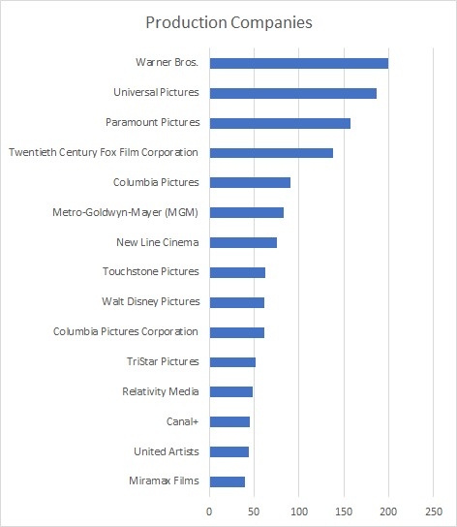
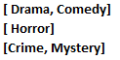
Preprocessing
TMDB Data
Categorical data in JSON format
Extracting Modal Class
Multilabel features

Slide 4
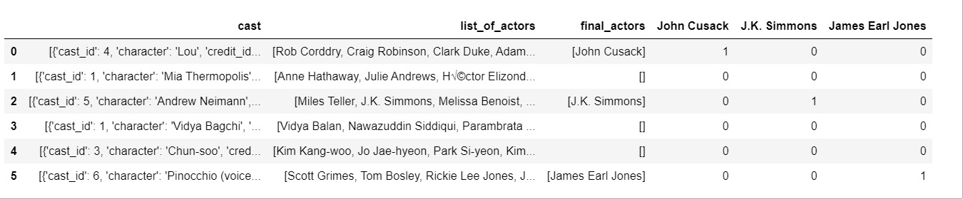
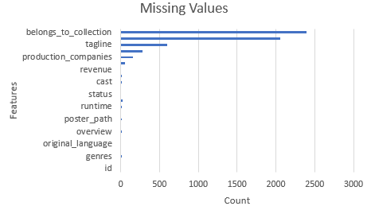
Preprocessing
Picking the most frequent cast, crew and production companies.
Feature Selection based on value addition to the model.
TFIDF of text column.
One hot Encoding(Month), Multilabel Binarizer(Genre, Prod Comp, Prod Country, Spoken Lang, Cast, Crew)

Slide 5
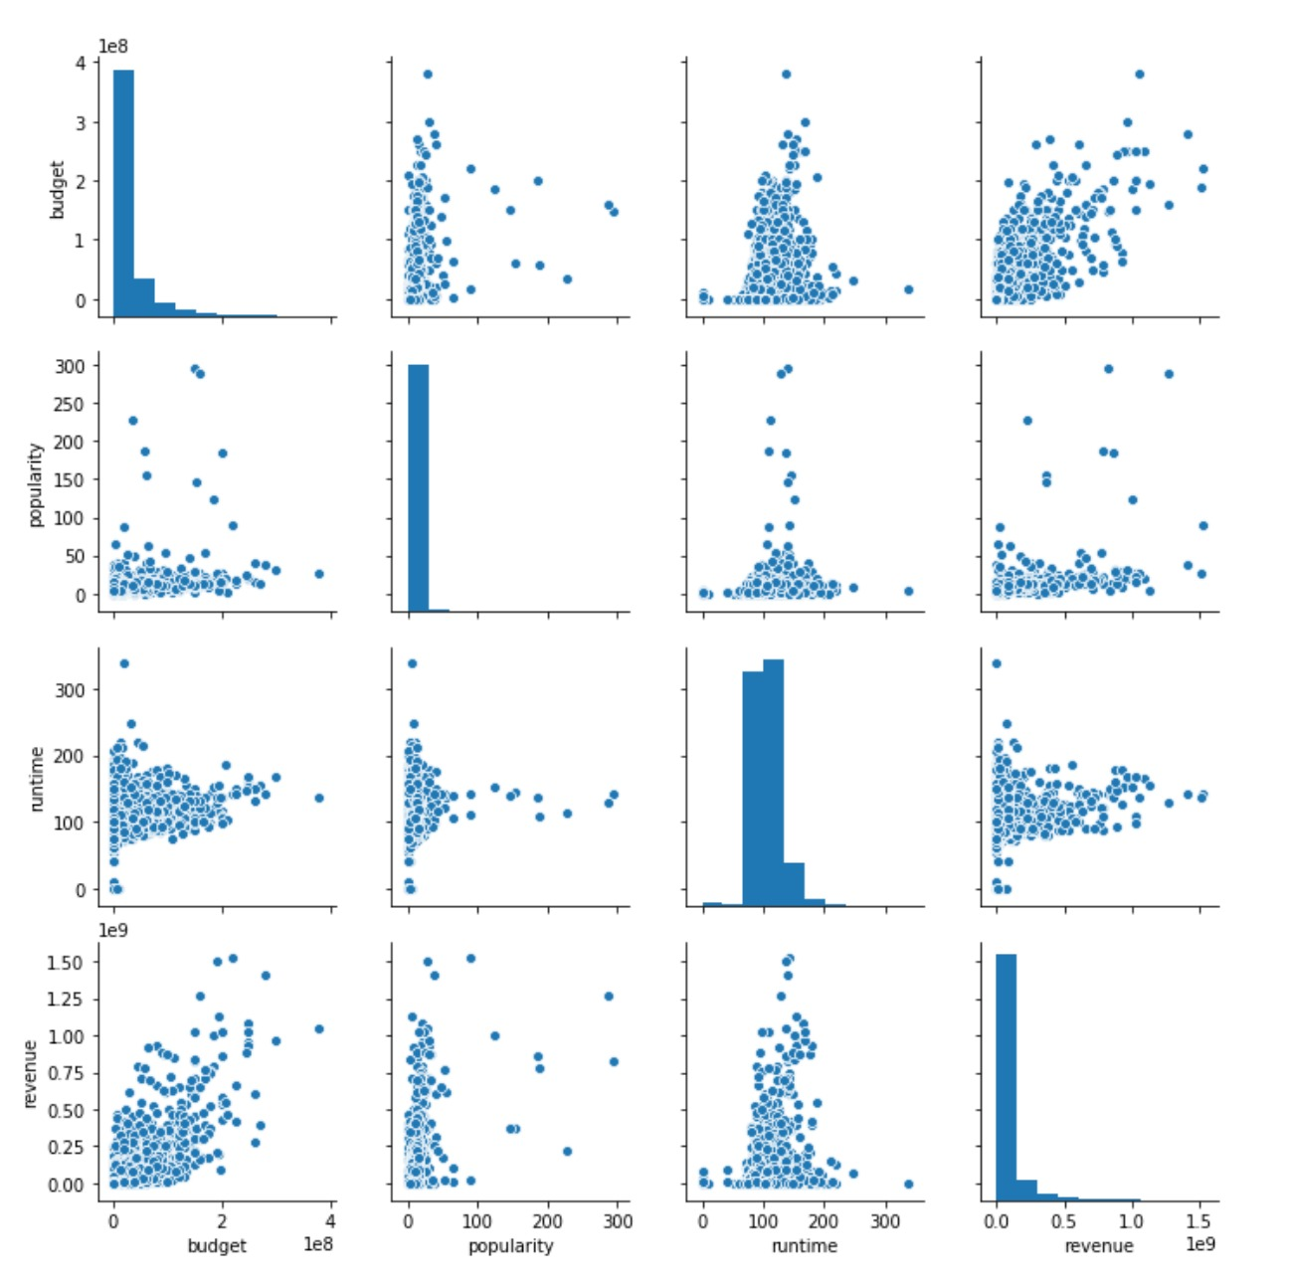
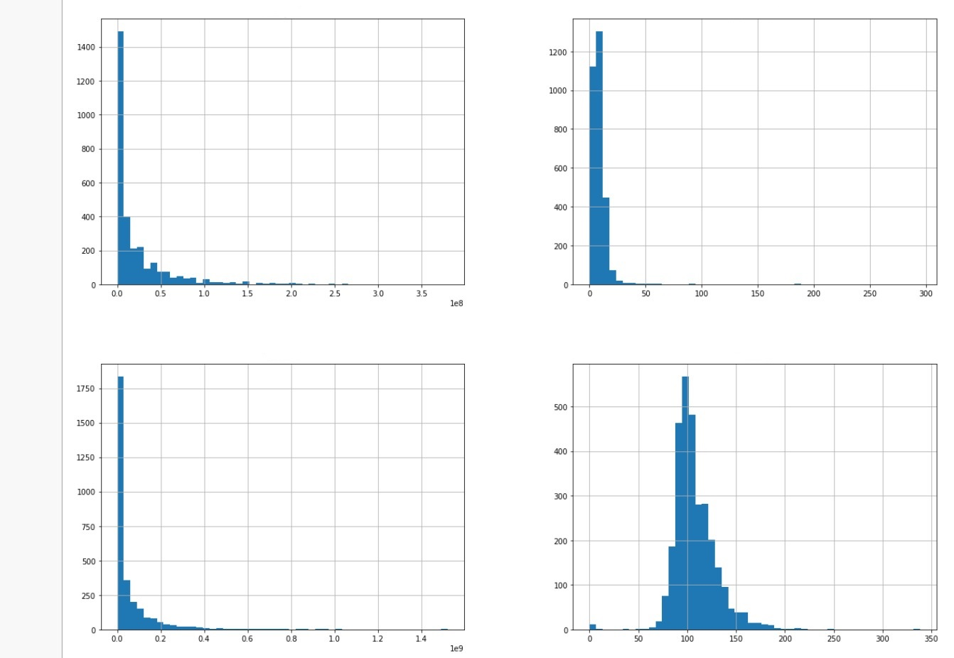
EDA
Feature Frequency Distribution
Feature Correlation Plot
Budget
Popularity
Revenue
Runtime

Slide 6







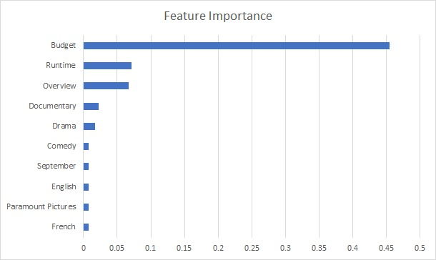




Result and Analysis
Model Selection
Models | RMSE
AdaBoost | 2.331
Random Forest Regressor | 1.696
XgBoost | 5.9022

Slide 7

Thank You

